Slide 1
Core Concepts

Slide 2
Intentional Design
We need to be careful with our design
So far, you’ve had simple assignments
Worked on your own
A few hours
Bad habits developed
As a professional, your projects will be much more complex
Will work on a large team
Projects can span years, with several incremental releases
You will have to build off of code written 5 years ago by someone else
Major projects don’t rewrite the system with new versions
They just change parts of the system

Slide 3
Bad Habits
Since programming assignments have been simple, you have gotten away with some bad habits
As programs get larger and more complicated, that doesn’t work
Notes:
Bad habits: no comments, poor design, code first ask Qs later, no testing, making assumptions, user interaction at all levels
Real world requires: collaboration with others, better design, very little time spent on writing code itself.

Slide 4
Reacting to Change
It is hard to predict what changes will come, but we know that changes will occur.
Notes:
Examples:
Customer changes requirements
Add more functionality
Port to another OS or to mobile
Market changes (new competitor, etc)
I won’t change requirements on you mid assignment, but I will between assignments

Slide 5
Design for Change
We have several practices and concepts that help us design our software and anticipate change
This is what makes the difference between a programmer, and a software engineer

Slide 6
Encapsulation
Grouping related data and operations together
We do this with classes and objects
State
Methods
We can keep data in sync

Slide 7
Without Objects…
We want to keep track of student information
We need parallel arrays
Each array has the information for the same student
Possibility for errors
A student object keeps this data together

Slide 8
Information Hiding
Note: Information Hiding and Encapsulation are often thought to be two terms for the same thing
They’re really two distinct, but related concepts
Information Hiding is how we control access to encapsulated data and operations
We do this by using our visibility settings
Private
Public
Package

Slide 9
Why hide information?
Why do we hide information?
The keep data in sync
To keep data accurate
To keep data secure
To not overwhelm other programmers with implementation details
How do computers solve for the square root of a number?
Do you really need to know, or do you just need to know that sqrt() returns the square root?
Consider building a house…

Slide 10
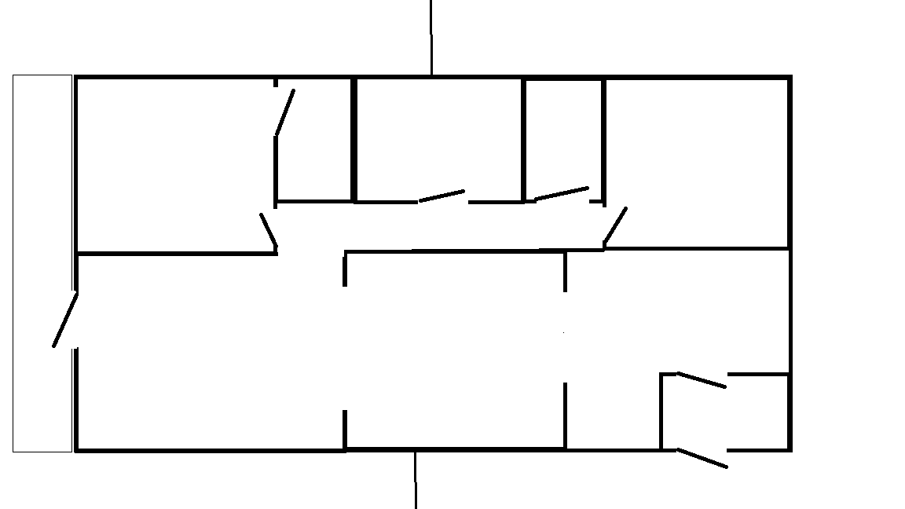

Slide 11
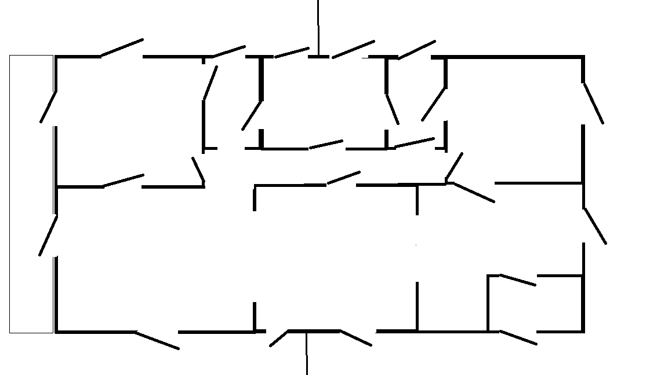

Slide 12
One simple example
Java has a Date class
The Date class example in the next slide has nothing to do with Java Date class
Not necessarily a great example, but it’s a convenient easy example!

Slide 13
One simple example
One possible Date Class representation
int day
int month
Int year
Representation invariant for valid Date
day, month, and year should be in “sync”
If day, month, and year can be modified arbitrarily, invalid dates could be represented
13/35/2017

Slide 14
One simple example
Through public methods provided by a class, access to the private representation can be controlled
Date class methods either may not let you set the day, month, and year independently or put preconditions
Unless there is related data to be “hidden” so that they can be kept in “sync”, grouped, and managed, classes may not be needed

Slide 15
Separation of Concerns
AKA Modular design
Every module has it’s own specific role and concerns
Modules then work together to solve a more complicated problem
Has a high initial overhead
Objects and Classes are modules
Notes:
This requires a more careful design. You need to identify the different roles, design each module, and design how they will work together before you right any code.

Slide 16
A good design helps with…
Reuse
Notes:
Reuse:
You can reuse the encapsulated objects.
Information hiding protects our data, even for systems we aren’t considering yet. The documentation tells us how to use it
By keeping the roles/concerns very specific, we can reuse it.
Consider making a POS system for a pizzeria. If we have one module whose role is processing credit card payments, we can reuse that module in another system. If the credit card payment system needs to know information about Pizzas, then it can only be used in a system for a pizzeria.

Slide 17
A good design helps with…
Reuse
Debugging
Notes:
Each encapsulated object can be tested individually. If a test case fails we know the bug is in that object.
Each Module has a specific role in the process. What role didn’t work? That module contains the bug
Hiding information limits access to the data. If the data is wrong, you have a limited number of places where that change could have been made.

Slide 18
A good design helps with…
Reuse
Debugging
Adapting to change
Notes:
SoC: if one role changes, and there is only one module that plays that role, its only one place to make the change. Command line to GUI
A well designed system is easier to build off of to add new functionality.

Slide 19
Design questions to ask
What if ___________ changes?
Any of your numbers
Avoid magic numbers
User interface
Have all input and output be in one module
Boundary objects
Order of events
What needs to be in what order, and what’s flexible
Clear documentation
Avoid repeated code
Separate into a module
One place to make a change

Slide 20
Design questions to ask
Does <object> know ________________? Should it?
Hide information
If an object A doesn’t need to know info about object B, then B can change without affecting A.

Slide 21
Design questions to ask
Are these related?
To encapsulate, or not to encapsulate
Encapsulating related things makes it easier to keep related data in sync
Encapsulating unrelated things makes it harder to reuse

Slide 22
Design questions to ask
Can someone use _______________ 5 years from now without having to ask me?
Do they need to know the programming language?
Do I have clear documentation and comments?
Did I hide implementation details, and use general abstract concepts
Notes:
Programming languages come and go, its why we don’t teach a ton of technical stuff, it changes too quickly. Visual Fox Pro project
Clear Doc: If someone doesn’t know what your code does, they’ll delete it and break the system.
Implementation details change. Vectors aren’t used in Java anymore

Slide 23
The importance of comments
What does this code do?
float foo( float number )
{
long i;
float x2, y;
const float threehalfs = 1.5F;
x2 = number * 0.5F;
y = number;
i = * ( long * ) &y;
i = 0x5f3759df - ( i >> 1 );
y = * ( float * ) &i;
y = y * ( threehalfs - ( x2 * y * y ) );
// y = y * ( threehalfs - ( x2 * y * y ) );
return y;
}

Slide 24
With comments and name
What does this code do?
float Q_rsqrt( float number )
{
long i;
float x2, y;
const float threehalfs = 1.5F;
x2 = number * 0.5F;
y = number;
i = * ( long * ) &y;
// evil floating point bit level hacking
i = 0x5f3759df - ( i >> 1 );
// what the f***?
y = * ( float * ) &i;
y = y * ( threehalfs - ( x2 * y * y ) );
// 1st iteration
// y = y * ( threehalfs - ( x2 * y * y ) );
// 2nd iteration, this can be removed
return y;
}

Slide 25

What does it do?
Fast inverse Square root
$\frac{1}{\sqrt{x}}$
Needed to be faster for computer graphics
https://en.wikipedia.org/wiki/Fast_inverse_square_root

Slide 26
Don’t worry
This is what this course is about
It takes time and practice to make these design decisions come naturally

